Slide 1
Movie Watching Group
Use case model

Slide 2
actors
Moderator: group manager incharge of tasks such as: creating a group, invite people into group, create movie watching event, initiate and close voting.
Group members: family members except the moderator, who can vote for the movies during movie watching events, search for movies, vote on movies and read movie comments.
Movie review site: the site that provide reviews for each movie that can be accessed by the group members.

Slide 3
Use cases
[UC01]login: login the movie watching system.
[UC02]veryfy password: verify the password when user click login
[UC03]display password error: display error when password is not correct.
[UC04]create movie group: create a group for new members.
[UC05]pull a movie list: create a list of movie and add them into group.
[UC06]inviting people: add more people into movie group.

Slide 4
Use cases
[UC07]create movie watching event: create a event and prepare for voting.
[UC08]open voting: open the voting channel for group members and inform group members.
[UC09]close voting: close voting, no group member can vote.
[UC010]elect movie winner: the movie winner will show up on screen.
[UC011]inform group member
[UC012]cast votes: vote for movie you like
[UC013]join a group: join a group created by moderator.

Slide 5
Use cases
[UC014]unsubscribe from a group: leave a group that you have joined before.
[UC015]search movie: search a movie by name.
[UC016]check movie reviews: check movie reviews.
[UC017]watch movie: you have option to watch trailer or whole movie.

Slide 6
[UC01]Use case discription
Use case ID: UC01
Use case title: LOGIN
Use case description: This use case starts when an use typed in his/her username and password into the system and click login button. This use case can only activated by group member and it will activate password verify case model as an included case model. It also have the option to display the error message according to specific condition.

Slide 7
[UC01]use case discription
Preconditions:
The device for using this application works well.
The internet is connected.
Postcondition:
Show the main interface of this application.
Steps: The user types in the username and password and click login button, the data in the bar will be send to the backend to be verified.

Slide 8
[UC02]use case discription
Use case ID: UC02
Use case title: VRIFY PASSWORD
Use case description: This use case is the included use case of UC01, each time UC01 is executed, UC02 will be automatically executed. This process can not be controlled by the user.

Slide 9
[UC02]Use case discription
Preconditions:
The device for using this application works well.
The internet is connected.
Passowrd is typed in.
Postcondition:
Data in the password input bar will be sent to the backend system. This data will be compare with the correct password in the database.
Steps: The user types in the username and password and click login button, the data in the bar will be send to the backend to be verified.

Slide 10
[UC03]Use case discription
Use case ID: UC03
Use case title: DISPLAY PASSWORD ERROR
Use case description: This use case is used when the user types wrong password into the input bar and then click the login button. This use case will probably be used after UC02 is processed.
Preconditions:
The device for using this application works well.

Slide 11
[UC03]Use case discription
Server works well.
The internet is connected.
US01 is invoked.
Postcondition:
A notice of “password wrong” will be generated on the screen and the data in the typing bar will be cleared.
Steps: The system compare the input data and the data in the database. The they are not matching and the system sends a “password wrong” notice to the user.

Slide 12
[UC04]use case discription
Use case ID: UC04
Use case title: CREATE MOVIE GROUP
Use case description: This use case is used when moderator create a new movie group. This group gives the moderator the option to invite people to this group or create a movie list.
Preconditions:
The device for using this application works well.

Slide 13
[UC04]Use case discription
Server works well.
The internet is connected.
US01 is invoked.
Postcondition:
A new interface will be displayed on the screen, including the button to invite new member and the button to create movie list.
Steps: The moderator set name, id to a group and click create movie group button. The server restore the information and create a new group.

Slide 14
[UC05]use case discription
Use case ID: UC05
Use case title: pull a movie list
Use case description: This use case is used when moderator adding new movies into the movie list. These movies are from outside links. Once these movies are added to the list, group members can access movies through these links.
Preconditions:
The device for using this application works well.

Slide 15
[UC05]Use case discription
Server works well.
The internet is connected.
Postcondition: a list of links of outside movie resource will be downloaded and displayed on the screen.
Steps: The moderator can search movie through a outside link and then add the links of the outside movies to this movie list.

Slide 16
[UC06]use case discription
Use case ID: UC06
Use case title: INVITING PEOPLE
Use case description: This use case is used when moderator add new members into one group. Moderator can add people by adding there email address or userID into the database. As a result, the users can login into the group because the server detected that the userID or email is the same as what the moderator has added.
Preconditions:
The device for using this application works well.

Slide 17
[UC06]Use case discription
Server works well.
The internet is connected.
Postcondition: The user information such as userID and email address are added into system databases.
Steps: The moderator type in the email address or userID into the bar and click add new member button.

Slide 18
[UC07]use case discription
Use case ID: UC07
Use case title: CREATE MOVIE WATCHING EVENT
Use case description: This use case is used when moderator create movie watching event. This event is basically a alert that will inform the group members to vote.
Preconditions:
The device for using this application works well.

Slide 19
[UC07]Use case discription
Server works well.
The internet is connected.
Postcondition: The user information such as userID and email address are added into system databases.
Steps: The moderator click the button to create the movie watching event. The channel for voting will be opened in the same time. The voting informing message will be sent to each group member that is in the list.

Slide 20
[UC08]use case discription
Use case ID: UC08
Use case title: OPEN VOTE
Use case description: This use case is used when a movie watching event is created. This use case can not be activated by actor directly, it is included in the action of creating a movie watching event.
Preconditions:
The device for using this application works well.

Slide 21
[UC08]Use case discription
Server works well.
The internet is connected.
Postcondition: The voting channel of each group member will be activiated.
Steps: the voting condition will transform from 0 into 1.

Slide 22
[UC09]use case discription
Use case ID: UC09
Use case title: CLOSE VOTE
Use case description: This use case is used any group member vote for the movie he/she want to watch.
Preconditions:
The device for using this application works well.

Slide 23
[UC09]Use case discription
Server works well.
The internet is connected.
Postcondition: The button for voting can not be clicked again
Steps: The group member click the button for voting, the voting condition will transform from 1 into 0.

Slide 24
[UC010]Use case discription
Use case ID: UC010
Use case title: Elect voting event winner
Use case description: This use case is the included use case of UC09, each time UC09 is executed, UC10 will be automatically executed. This process can not be controlled by the user. The system count the most voted movie and mark it as the winner.
Preconditions: The voting event is closed.
Postcondition: System has stored the winner in this voting event .
Steps: The System finds the movie that has the largest voted number.

Slide 25
[UC011]Use case discription
Use case ID: UC011
Use case title: Informe group members the voting event winner
Use case description: This use case is the included use case of UC09, each time UC09 is executed, UC11 will be automatically executed. This process can not be controlled by the user. The system sends a message about the voting event for all members.
Preconditions: The voting event is closed.
Steps: Send all members a message about the voting winner.

Slide 26
[UC012]Use case discription
Use case ID: UC012
Use case title: Cast votes
Use case description: This use case starts when an use votes for a movie in a voting event. This use case can only activated by group member and the system will count the number. Each memebr can only vote once for one movie.
Preconditions: The group has at least one ongoing voting event.
Postconditons: Posting the voting success message to the user.
Steps: The user into a voting event, and vote for a listed movie.

Slide 27
[UC013]Use case discription
Use case ID: UC012
Use case title: Join a group
Use case description: This use case is designed for users to join a group. It only can be activcated by any user. The user can not selected the joined groups. The selected group will add the user into member list.
Preconditions: The system has at least one group that the user is not the member.
Postconditions: The selected group has add the user into the member list.
Steps: The user selected a group from the group list, and click the join button.

Slide 28
[UC014]Use case discription
Use case ID: UC014
Use case title: Unsubscribe
Use case description: The use case is used by the group members leave a group that you have joined before. This use case can only active by the group members who have already in a group.
Preconditions: The group member have already been in a group.

Slide 29
[UC014]Use case discription
Postcondition:
The group member leave the group and all functions in this group could not be used by this member.
Steps:
When the group member click the unsubscribe button, the system will remove the group member from the member list of the group that the member joined before.

Slide 30
[UC015]Use case discription
Use case ID: UC015
Use case title: Search
Use case description: The use case is designed to use a movie name to search the movie you want.
Preconditions:
The device for using this application works well.

Slide 31
[UC015]Use case discription
Postcondition:
The relevant search results (movie name) will be shown on the screen. If there is no match result, it will show “No result”.
Steps:
The system will compare the movie name you entered with the movie name in the database. If there has match movies, the system will return the top relevant movies. Otherwise, it will return no results exception.

Slide 32
[UC016]Use case discription
Use case ID: UC016
Use case title: Movie Reviews
Use case description: The use case is designed to show the movie reviews of the special movie. These reviews is extracted from the movie reviews site by its API.
Preconditions:
The movie reviews site has this movie and its reviews.

Slide 33
[UC016]Use case discription
Postcondition:
The movie reviews will be store in the system database and show on the screen after extracted from movie reviews site.
Steps:
When the user click this button, the system will use the movie reviews site API to extract the reviews on this site. Then the reviews will be store in the system own database and it will show on the screen.

Slide 34
[UC017]Use case discription
Use case ID: UC017
Use case title: Watch movie
Use case description: The use case is used to give group member options to choose watching the trailer or the whole movie.
Preconditions:
The movie is in the movie database or you already in the movie description page.

Slide 35
[UC017]Use case discription
Postcondition:
It will show the trailer or the whole movie choice button on the screen. Each button is responding to movie trailer or whole movie.
Steps:
The user click the trailer or whole movie button, the system will get the corresponding video resource on the screen.

Slide 36
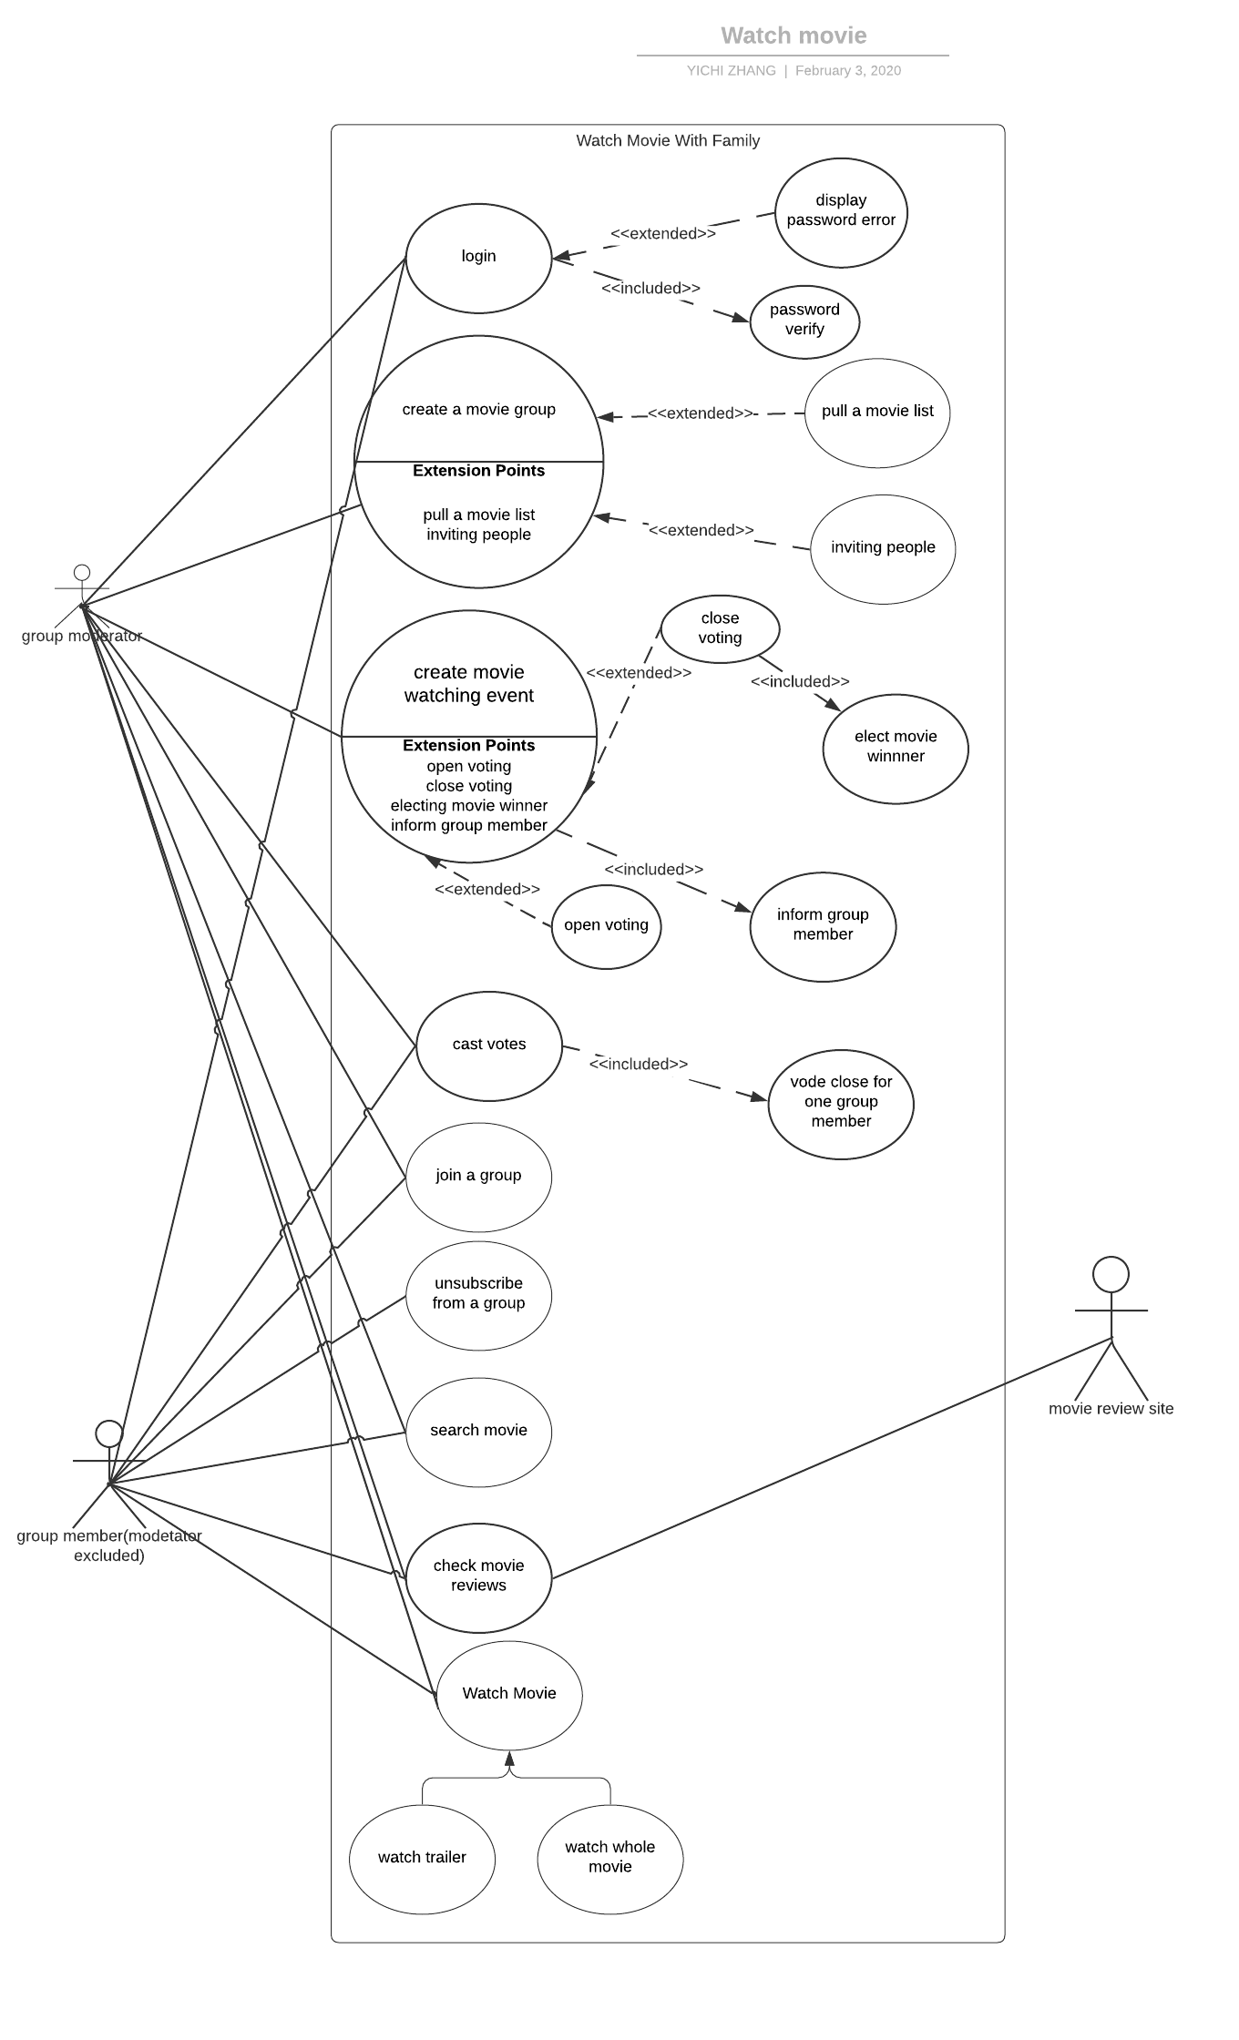
Diagrams

